Slide 1

Name- Kasim Khan
Title of Assignment: Information Technology
and Automobile Industry
Teacher In-Charge: Christopher Thongkhanthang Sir

Slide 2
Introduction to roles of IT and Automobile Industries
In this presentation we highlights the fundamental roles of the Information Technology and Automobile industries in driving economic transformation. Both industrial sectors act as engines of innovation, boosting productivity and fostering new business opportunities.
We will analyze key technological developments, market trends, and their influence on global economic growth. Understanding these industries offers valuable insights into future economic challenges and opportunities, crucial for strategic decision-making in a competitive environment.

Slide 3

Economy Information Technology and Automobiles Industries
Information Technology plays a critical role in driving economic growth by fostering innovation and enhancing productivity. It enables businesses to streamline operations,
access new markets and improve service delivery.
As a catalyst for digital transformation, IT helps economies and compete globally, making it important factor in sustainable development.
← </build_future>

Slide 4

01
Information Technology Sector

Slide 5
INTRODUCTION:
The Information Technology (IT) sector involves the use of computers, software, networks, and systems to manage and process information. In 2025, the global IT market size is about $9.6 trillion, growing at a steady
rate of around 7.7% annually.
Emerging technologies like artificial intelligence (AI), machine learning, and 5G connectivity are shaping the future of IT.
IT plays a crucial role in driving economic growth, innovation, and productivity across all industries.
Main components of IT sector :
Hardware, Software, IT Services, Cloud Computing and
Cybersecurity.

Slide 6

Future scope and career in IT
The IT sector is expected to see rapid expansion driven by artificial intelligence (AI), machine learning and also creating new possibilities in healthcare, finance, education, manufacturing, data analytics ,internet of things and telecommunications
The IT industry provides many career opportunities in which
Many diverse role are available as :
*Data analyst , Data scientist ,AI/ML Engineer----Skills needed (in python , R, SQL), * Software developer---JAVA , PYTHON,C++, JAVA SCRIPT
Cybersecurity Analyst ,Ethical Hacker,Cloud Engineer,IT Support Technician,Database Administrator etc.

Slide 7
Key Technologies and
Innovations
Emerging technologies like artificial intelligence, blockchain, and the Internet of Things are transforming the Information Technology landscape. These innovations enhance operational efficiency, enable precise data-driven decisions, and strengthen global connectivity.
By integrating these technologies across industries, businesses accelerate innovation, improve service delivery, and drive economic growth. This convergence sets the foundation for continued technological advancements and long-term competitive advantages in diverse sectors.

Slide 8
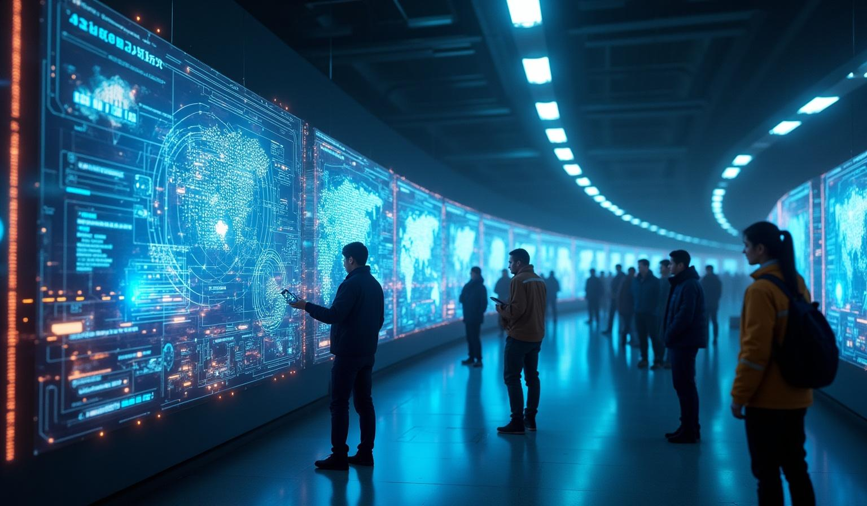
Impact of IT industry on Global Economy
</innovation_pipeline>
The global economy is significantly impacted by both the Information Technology and Automobile industries. IT drives productivity and innovation, enabling businesses worldwide to operate more efficiently and enter new markets.
Meanwhile, the automobile industry supports vast employment and supply chains, with advancements like electric vehicles promoting sustainability. Together, these sectors stimulate economic growth, foster global trade, and enhance competitive advantage in a rapidly changing market environment.

Slide 9

02
Automobile Industry

Slide 10
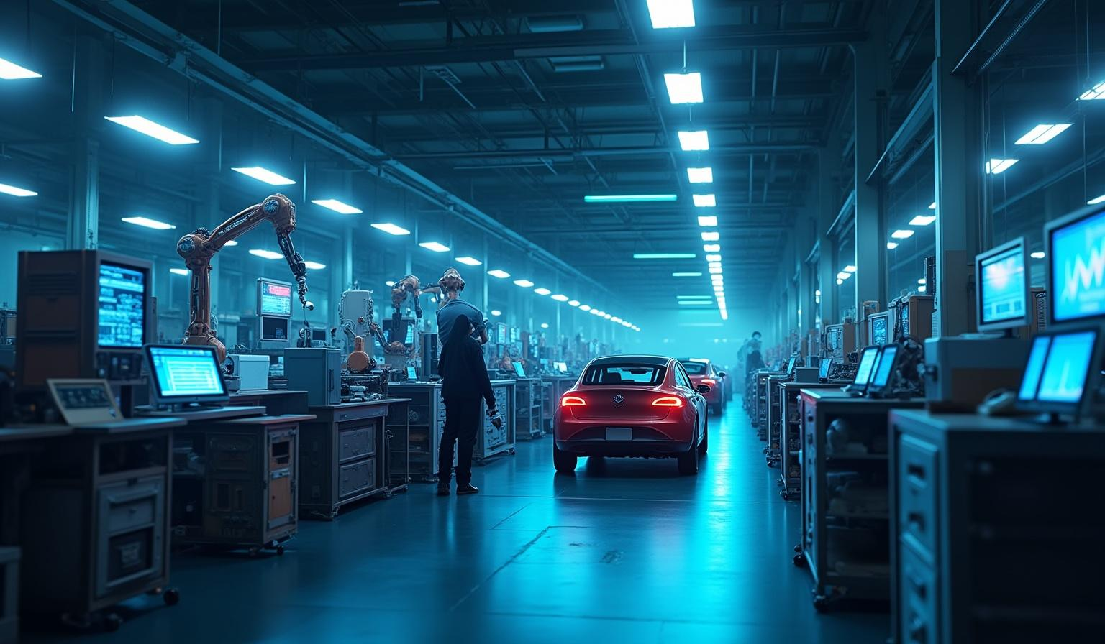
INTRODUCTION :
</innovation_pipeline>
It is a pillar of indian economy. The automobile industry is not just about cars, It is a giant engine for the entire Indian economy. It contributes 7.1% to India's total GDP and a massive 49% to the country's manufacturing GDP. The automobile industry continually evolves through significant technological advances such as electric vehicles, autonomous driving, and smart manufacturing systems. .

Slide 11
AUTOMOBILES HUBS:
India‘s Automobiles hubs is clustered in many key zones in wich major hubs in india are :
In North :The Gurugram-Manesar(Faridabad) –major hub for companies like Maruti Suzuki .
In West: The “Detroit of india “ (Pune {Mahrasahtra } –hosting over 4000 manufacturing unit, including Tata motors , Mahindra , and Volkswagen.
In South :The “ Detroit of Asia “(Chennai {Tamil Naidu }) –called the “Automobile Hub” of india , produces (1/3 rd ) 60% of india auto exports .
In East : The “Kolkata Jamshedpur Cluster “(Kolkata {west Bengal}) –hub of companies like Tata Motors and Hindustan Motors
The Information Technology and Automobile industries serve as vital engines for economic growth, driving digital transformation and innovation that improve efficiency across multiple sectors.
.

Slide 12
Economic Contributions and Market Dynamics
The automobile industry plays a crucial role in the economy by generating substantial employment, export revenues, and tax contributions. Its extensive supply chain supports many related industries, amplifying its economic impact.
Market dynamics in this sector are shaped by continuous technological innovation, shifting consumer preferences, and evolving global trade regulations. These factors highlight the industrys significance in promoting economic stability and fostering sustainable growth worldwide.

Slide 13
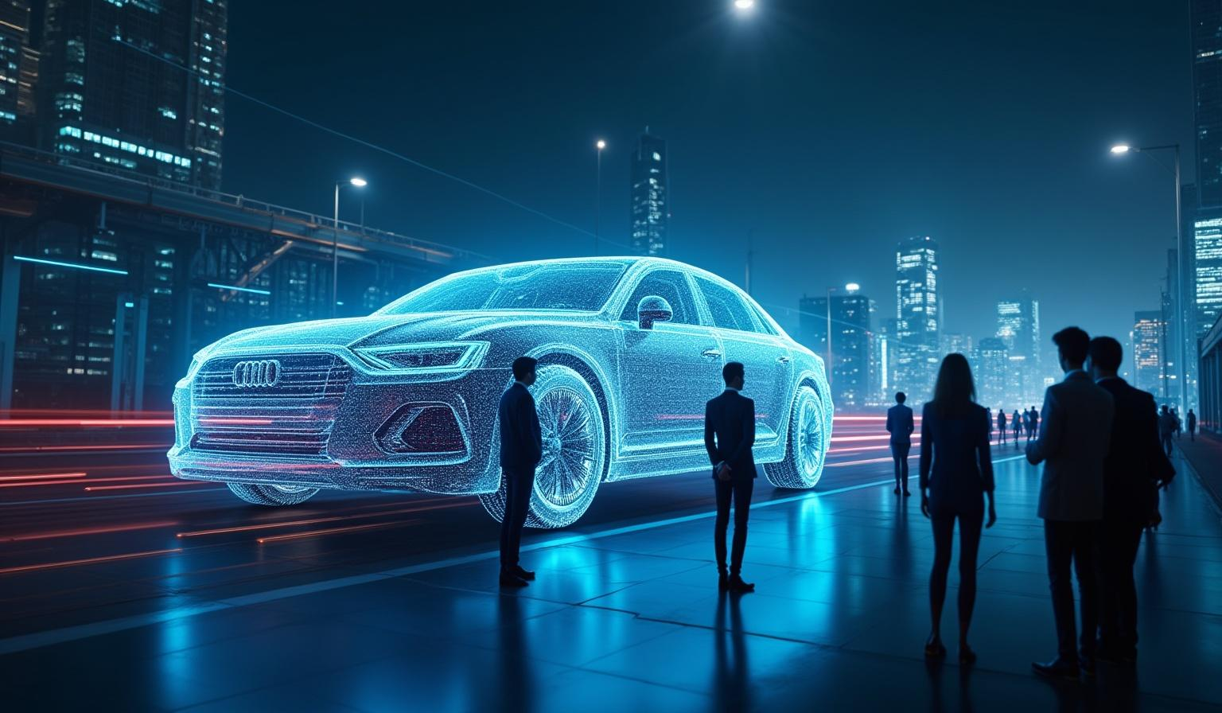
Conclusions
>
In conclusion both sector , is the backbone of information technology and manufacturing industries . The IT and Automobile industries are essential pillars of economic progress. IT fuels digital transformation and continuous innovation, enhancing efficiency across india .
Simultaneously, the automobile industry advances through technological breakthroughs and a shift toward sustainable practices. Their combined impact generates significant economic value, while also introducing strategic challenges and opportunities that will define the trajectory of global markets and industry evolution.

Slide 14
THANK YOU!!!
X
Thank you for your attention and engagement throughout this presentation. The roles of Information Technology and the Automobile industry are vital to the future of global economic growth and innovation.

